Slide 1
Modeling and Simulation in SIMSCRIPT II.5
A complete, modern, general purpose programming language
  English like syntax is self documenting
  Data structures make programming easier and faster
  Highly portable language
A powerful discrete event simulation language
  Models a system as it evolves over time
  Timing routine and event set handled automatically
SIMSCRIPT
Notes:
30

Slide 2
Variables
Variables have a mode
  Integer Let number = 1
  Real, Double Let money = 5.50
  Alpha Let grade = “A”
  Text Let title = “Far and away”
  Pointer ... Address of an entity
SIMSCRIPT
Notes:
30

Slide 3
Control Structures
  Assignments
  Branches
  Loops
  Input
  Output
  Routines and functions
SIMSCRIPT
Notes:
30

Slide 4
Entities, Attributes and Sets
Entity : an item of interest
  e.g. a communications packet; an airplane
Attribute: characteristic of an entity
  e.g. source, destination, priority;
  tail number, takeoff weight
Set: collection of entities
  e.g. transmission queue of packets to be processed; a fleet of airplanes.
SIMSCRIPT
Notes:
30

Slide 5
Entities, Attributes and Sets (cont.)
Suppose you are modeling a communications center. The center has a name and a processing rate and owns a queue of packets. Each packet in the queue has some characteristics, say, a destination name and a priority.
We say that:
  The communications center and packet are entities.
  The name and processing rate are attributes of the center.
SIMSCRIPT
Notes:
30

Slide 6
Entities, Attributes and Sets (cont.)
  The destination name and priority are attributes of the packet
  The queue is a set owned by the center.
  The packets are members of the set.
SIMSCRIPT
Notes:
30

Slide 7
Three Things We Can Do With Sets
File entities in a set
Search the set for a particular entity
Remove entities from a set
SIMSCRIPT
Notes:
30

Slide 8
Sets Have Disciplines
First-In, First-Out(FIFO): (Default)
Last-In, First-Out(LIFO):
  Define TRANSMISSION.QUEUE as a LIFO set
Ranked by an attribute
  Define TRANSMISSION.QUEUE as a LIFO set
  ranked by high PKT.PRIORITY
In case of ties: FIFO
All ranking done on filing only
SIMSCRIPT
Notes:
30

Slide 9
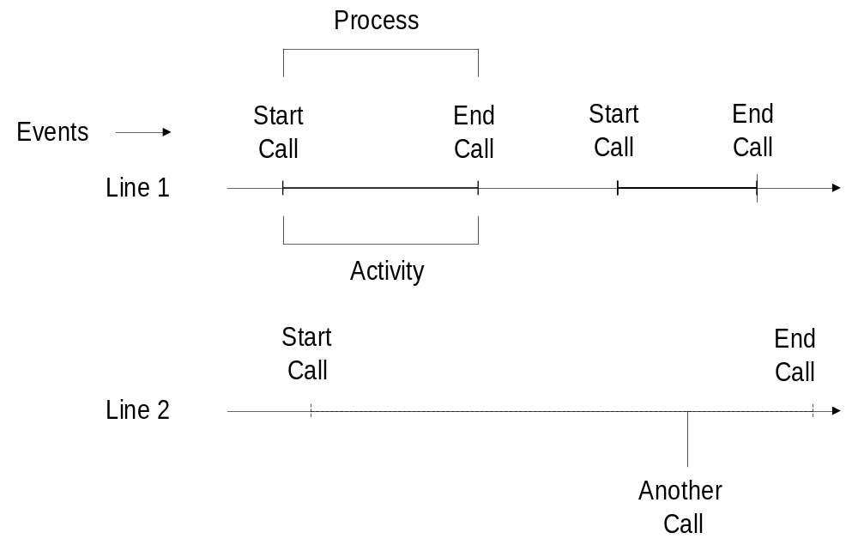
Modeling the Passage of Time
SIMSCRIPT
Notes:
30

Slide 10
Discrete Event Simulation
An event is instantaneous
Something of importance happens at an event
  State variables may change
  Entities are created or destroyed
  Entities are filed or removed from a set
  Another event is scheduled to occur
Time passes by doing nothing until the next event occurs
SIMSCRIPT
Notes:
30

Slide 11
Next-event Time Advance
You don’t move the clock ahead a certain amount then ask what has happened (fixed-increment time advance).
You ask when the next event is to occur, set the clock to that time, then execute the event routine.
SIMSCRIPT
Notes:
30

Slide 12
Discrete Process Simulation
Process oriented approach simplifies larger models by allowing all of the behavior of an activity to be described in one or more process routines.
Simulation time may elapse at one or more points in the process routine.
SIMSCRIPT
Notes:
30

Slide 13
Program Structure
Note that a program has several well defined sections.
PREAMBLE:
  The Preamble contains only declarative information (no executable statements)
  All Simscript entities must be declared in the Preamble
  All global variables must be declared in the Preamble
SIMSCRIPT
Notes:
30

Slide 14
Program Structure (cont.)
MAIN:
  Execution starts in Main
ROUTINES:
  Routines are called (from Main or other Routines) and return control to the calling routine
FUNCTIONS:
  Functions are called by reference in arithmetic expressions
  User functions must be declared in the Preamble
SIMSCRIPT
Notes:
30

Slide 15
Global vs. Local Variables
Global Variables:
  Must be defined in the Preamble
  Can be used in any routine (except where redefined locally)
  Are initialized to zero at start of execution (only)
SIMSCRIPT
Notes:
30

Slide 16
Global vs. Local Variables (cont.)
Local Variables:
  Are defined within a Routine
  Can be used only in that Routine
  Are initialized to zero every time the Routine is entered, Unless:
    The variable is declared to be SAVED
    Or, it is an argument passed to the Routine
SIMSCRIPT
Notes:
30

Slide 17
SIMSCRIPT II.5 Preamble,
Queueing Model
1 PREAMBLE
2 PROCESSES INCLUDE ARRIVAL.GENERATOR,
3 CUSTOMER, AND REPORT
4 RESOURCES INCLUDE SERVER
5 DEFINE DELAY.IN.QUEUE, MEAN.INTERARRIVAL.TIME,
6 AND MEAN.SERVICE.TIME AS REAL VARIABLES
7 DEFINE TOT.DELAYS AS AN INTEGER VARIABLE
8 DEFINE MINUTES TO MEAN UNITS
9 TALLY AVG.DELAY.IN.QUEUE AS THE AVERAGE AND
10 NUM.DELAYS AS THE NUMBER OF DELAY.IN.QUEUE
11 ACCUMULATE AVG.NUMBER.IN.QUEUE AS THE
12 AVERAGE OF N.Q.SERVER
13 ACCUMULATE UTIL.SERVER AS THE AVERAGE OF
14 N.X.SERVER
15 END
SIMSCRIPT
Notes:
65

Slide 18
SIMSCRIPT II.5 Main program
Queueing Model
1 MAIN
2
3 READ MEAN.INTERARRIVAL.TIME,
4 MEAN.SERVICE.TIME, AND TOT.DELAYS
5
6 CREATE EVERY SERVER(1)
7 LET U.SERVER(1) = 1
8
9 ACTIVATE AN ARRIVAL.GENERATOR NOW
10
11 START SIMULATION
12
13 END
SIMSCRIPT
Notes:
66

Slide 19
SIMSCRIPT II.5 Process routine
ARRIVAL.GENERATOR
1 PROCESS ARRIVAL.GENERATOR
2
3 WHILE TIME.V >= 0.0
4 DO
5 WAIT EXPONENTIAL.F(MEAN.INTERARRIVAL.TIME,
6 1) MINUTES
7 ACTIVATE A CUSTOMER NOW
8 LOOP
9
10 END
SIMSCRIPT
Notes:
67

Slide 20
SIMSCRIPT II.5 Process routine
CUSTOMER
1 PROCESS CUSTOMER
2
3 DEFINE TIME.OF.ARRIVAL AS A REAL VARIABLE
4 LET TIME.OF.ARRIVAL = TIME.V
5 REQUEST 1 SERVER(1)
6 LET DELAY.IN.QUEUE = TIME.V - TIME.OF.ARRIVAL
7 IF NUM.DELAYS = TOT.DELAYS
8 ACTIVATE A REPORT NOW
9 ALWAYS
10 WORK EXPONENTIAL.F (MEAN.SERVICE.TIME, 2)
11 MINUTES
12 RELINQUISH 1 SERVER(1)
13
14 END
SIMSCRIPT
Notes:
68

Slide 21
SIMSCRIPT II.5 Process routine
REPORT
1 PROCESS REPORT
2
3 PRINT 5 LINES THUS
SIMULATION OF THE M/M/1 QUEUE
9 PRINT 8 LINES WITH MEAN.INTERARRIVAL.TIME,
10 SERVICE.TIME, AND TOT.DELAYS THUS
MEAN INTERARRIVAL TIME **.**
MEAN SERVICE TIME **.**
NUMBER OF CUSTOMERS *****
SIMSCRIPT
Notes:
69

Slide 22
SIMSCRIPT II.5 Process routine
REPORT(Continued)
19 PRINT 8 LINES WITH AVG.DELAY.IN.QUEUE,
20 AVG.NUMBER.IN.QUEUE(1), ANDUTIL.SERVER(1)
21 THUS
AVERAGE DELAY IN QUEUE ***.**
AVERAGE NUMBER IN QUEUE ***.**
SERVER UTILIZATION *.**
29 STOP
30
31 END
SIMSCRIPT
Notes:
70

Slide 23
SIMSCRIPT II.5 Output Report
Queueing Model
SIMULATION OF THE M/M/1 QUEUE
MEAN INTERARRIVAL TIME 1.00
MEAN SERVICE TIME .50
NUMBER OF CUSTOMERS 1000
AVERAGE DELAY IN QUEUE .43
AVERAGE NUMBER IN QUEUE .43
SERVER UTILIZATION .50
SIMSCRIPT
Notes:
71

Slide 24
How Does SIMSCRIPT II.5 Handle the Details?
There are four key elements:
The process notice
The event set
The timing routine
The process routine
SIMSCRIPT
Notes:
30

Slide 25
The Process Notice
A special type of temporary entity containing data needed to execute one copy or instance of the process; nine Simscript II.5 attributes
  Activate an INCOMING.CALL at 8
  Creates the process notice
  Sets time.a to 8
  Files the process notice in the event set
SIMSCRIPT
Notes:
30

Slide 26
SIMSCRIPT Sets
A set is :
  An ordered list of one type of entity
  Owned by some entity
  Efficient in both space and processing time
(Example)
  Every MACHINE owns a JOB.LIST
  Every JOB belongs to a JOB.LIST
  Define JOB.LIST as a fifo set
SIMSCRIPT
Notes:
30

Slide 27
SIMSCRIPT Sets (cont.)
A set ranked by low time.a
Contains all process notices in order of occurrence
It is called ev.s
SIMSCRIPT
Notes:
30

Slide 28
Set Processing Commands
There are three basic operations on sets:
  Inserting new members into the set (FILE)
  Deleting members from the set (REMOVE)
  Searching the set for members with certain attribute values (FOR EACH OF SET)
SIMSCRIPT
Notes:
30

Slide 29
Set Processing Commands(cont.)
INSERTING
  File JOB in JOB.LIST(MACHINE) means:
  1. Place existing entity JOB pointed to by the pointer variable JOB in the set named JOB.LIST owned by the entity MACHINE.
  2. The entity will be placed either at the head or the tail of the list, depending upon the discipline of JOB.LIST.
(Variations)
File JOB first in JOB.LIST(MACHINE)
File JOB last in JOB.LIST(MACHINE)
File JOB before MY.JOB in JOB.LIST(MACHINE)
File JOB after MY.JOB in JOB.LIST(MACHINE)
SIMSCRIPT
Notes:
30

Slide 30
Set Processing Commands(cont.)
DELETING
Remove first JOB from JOB.LIST(MACHINE) means:
  1. Remove the entity at the head of the JOB.LIST owned by the entity MACHINE.
  2. Place the pointer to this newly removed entity in the pointer variable JOB.
  3. If the set was empty when this operation was attempted, raise an error condition.
  (Variations)
Remove the last JOB from JOB.LIST(MACHINE)
Remove this JOB from JOB.LIST(MACHINE)
(Which JOB? -- the one pointed to by the JOB)
SIMSCRIPT
Notes:
30

Slide 31
The Timing Routine
Activate must have a time phrase:
Activate a DEPARTURE at 8
Activate a DEPARTURE in 20 minutes
Activate a DEPARTURE now
SIMSCRIPT
Notes:
30

Slide 32
The Timing Routine
Start Simulation
Any
Process or Event
No
Return
Notices in the Event
Set
Yes
Select Process or Event Notice
with Earliest Execution Time
Update Simulation Clock to
Time of Process or Event
Determine type of
Process or Event
Remove Process or Event Notice
from the Event Set
Execute the Process or
Event Routine
SIMSCRIPT
Notes:
30

Slide 33
How do we Model a Process?
For a single instance of the process, write down the steps in order of occurrence.
Activate it every time we want a process to occur.
SIMSCRIPT II.5 will take of the rest
SIMSCRIPT
Notes:
30

Slide 34
Process Routine
Process INCOMING.CALL
If NUMBER.BUSY < 2
Add 1 to NUMBER.BUSY
Wait 10.0 minutes
Subtract 1 from NUMBER.BUSY
Else
Add 1 to LOST.CALLS
Endif
End ‘‘ INCOMING.CALL
SIMSCRIPT
Notes:
30

Slide 35
Resources
Queueing systems can be modeled using Resources
Resources are variants of permanent entities
Create every CIRCUIT(2)
Let U.CIRCUIT(1) = 2
Let U.CIRCUIT(2) = 3
Process INCOMING.CALL
Request 1 CIRCUIT(2)
Wait 2 minutes
Relinquish 1 CIRCUIT(2)
End ‘‘ INCOMING.CALL
SIMSCRIPT
Notes:
30

Slide 36
Collecting Statistics
Number of occurrences
Maximum / Minimum
Sum / Mean
Sum of squares
Mean square
Variance
Standard deviation
Histogram
SIMSCRIPT
Notes:
30

Slide 37
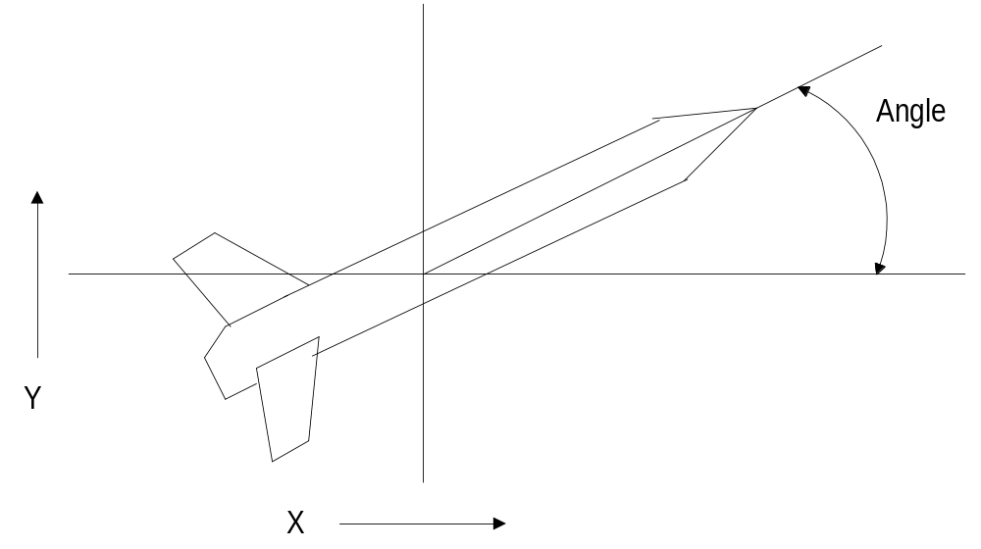
Continuous Simulation
SIMSCRIPT
Notes:
30

Slide 38
Missile Flight Problem
Given an equation for the rate of change of a variable, calculate the value of the variable continuously
d(angle) / dt = -.1 (radians/sec)
dx / dt = speed * cos(angle)
dy / dt = speed * sin(angle)
SIMSCRIPT
Notes:
30

Slide 39
Continuous Variables
Preamble
Processes include MSL
Every MSL has an X, Y, and ANGLE
Define X, Y, ANGLE as continuous
real variables
End ‘‘ Preamble
SIMSCRIPT
Notes:
30

Slide 40
Routine EQUATIONS
Routine EQUATIONS
Let D.ANGLE(MSL) = -.1 ‘ ‘ radians/second
Let D.X (MSL) = SPEED (MSL)
* cos.f( ANGLE (MSL))
Let D.Y (MSL) = SPEED (MSL)
* sin.f (ANGLE (MSL))
End ‘‘ EQUATIONS
SIMSCRIPT
Notes:
30

Slide 41
Process MISSILE
Process MSL
Wait continuously evaluating ‘EQUATIONS’
testing ‘QUIT’
End ‘‘ MSL
SIMSCRIPT
Notes:
30

Slide 42
More Details on SIMSCRIPT
Defining Arrays
Arrays have mode and dimensionality
All elements are of the same mode
Mode and dimensionality are determined at compile time
The size of array may be determined at run time
(Example)
Define MATRIX as a 2-dim, real array
Define VECTOR as a 1-dimensional, integer array
Define TABLE as a 3-dim, real array
SIMSCRIPT
Notes:
30

Slide 43
Initializing Arrays
Allocating Space for Arrays
  The space for an array is allocated during execution
(Example)
Reserve VECTOR as 32
Reserve TABLE as 10 by 32 by 8
  The value of all array elements is initially zero!
  (automatically)
SIMSCRIPT
Notes:
30

Slide 44
Ragged Arrays
It is possible to allocate storage for the data elements of an array such that each data row is (potentially) of a different length.
The other dimensions must be fixed.
(Example)
Define RAGGED_ARRAY as a 2-dim, integer array
Reserve RAGGED_ARRAY as 4 by *
For I = 1 to 4
Reserve RAGGED_ARRAY(I, *) as I
Result of an
array reserved
SIMSCRIPT
Notes:
30

Slide 45
Manipulating Arrays
Array elements are referenced by subscripting the array name
(Example)
Let VECTOR(5) = 48 or
Let TABLE(5, 3, 7) = 16.5
  Subscript values range from 1 to the specified maximum.
To generalize the searching over the elements of an array, a function is available to access the maximum subscript of an array (in each dimension): dim.f(*, *, *)
SIMSCRIPT
Notes:
30

Slide 46
Free Format Input
Simscript input need not be rigidly formatted
Simscript input is not record oriented
Simscript input is field oriented
A field is a sequence of nonblank characters
Fields are separated by one or more blanks (not commas!)
In most cases the end of record also ends a field
Mode conversion is automatic (where allowed)
SIMSCRIPT
Notes:
30

Slide 47
Free Format Input (cont.)
  (Example)
  Read X, Y, and Z
  possible data: 7 3.2 6.8
  or 8.45 5.6
  4.3
  or 7 3.2 6.8 8.45 5.6 4.3
  ^
  (as many records as necessary are read to fill the variables)
SIMSCRIPT
Notes:
30

Slide 48
Free Format Output
The simplest way to produce output is the list statement:
  List X, Y, Z and COUNTER
  would produce:
  X = 8.45 Y = 5.6 Z = 4.3 COUNTER = 5
Arrays may also be listed in free form with the list statement, For example,
    List MATRIX
  would list all the elements of the array MATRIX, labeling each one
SIMSCRIPT
Notes:
30

Slide 49
An Array Processing Example
We now have all the pieces for a simple example.
To input two vectors, multiply them element by element, and display the product,
  Main
  Define X, Y and Z as 1-dim, real arrays
  Define I and SIZE as integer variables
  Read SIZE
  Reserve X, Y and Z as SIZE
  For I = 1 to SIZE
  Do Read X(I) and Y(I)
  Let Z(I) = X(I) * Y(I)
  List X(I), Y(I), and Z(I)
  Loop
  End
SIMSCRIPT
Notes:
30

Slide 50
SIMSCRIPT Syntax Rules
There are no statement delimiters in Simscript
There are no statement continuation marks in Simscript
Statements begin with a Key Word
Key words are not reserved words
No variable name, keyword or literal may be broken at the end of a line
Statements may extend over as many lines as necessary
SIMSCRIPT
Notes:
30

Slide 51
SIMSCRIPT Syntax Rules (cont.)
Comments begin with two apostrophes (‘‘) -- not a quote mark, and
  end either:
  1. at the end of the record
  2. or at the next pair of apostrophes (on the same line)
System Variables
  All predefined Variables have names ending in “.letter”, for example,
  pi.c (constant) hours.v (variable)
  sqrt.f (function) timer.r (routine)
SIMSCRIPT
Notes:
30

Slide 52
SIMSCRIPT Syntax Rules (cont.)
All System-Generated Variables have names beginning with “letter.”
  (Examples)
  N.MACHINE L.BAKERY.QUEUE
User-Defined Variables
  Any combination of letters, digits, periods, and underscores, which is not a number (Terminal periods are ignored)
  (Examples)
  AIRPLANE NO.OF.TERMINALS
SIMSCRIPT
Notes:
30

Slide 53
Formatted Output
The PRINT Statement:
  Any number of variables and expressions may be printed in a single PRINT statement
  Any number of lines of text format may be specified
  Variables are inserted into format fields in sequence (There must be a 1 to 1 correspondence)
  Format fields are comprised of asterisks and periods (Blanks extend the field to the left only)
SIMSCRIPT
Notes:
30

Slide 54
Formatted Output (cont.)
  (Example)
  Print 2 lines with X and X**2 thus
  The current value of x is *.**
  The value of x-squared is *.****
To introduce blank lines:
Skip n lines
To go to a new output page:
Start new page
SIMSCRIPT
Notes:
30

Slide 55
Formatted Output (cont.)
To describe formats longer than the standard input record:
  Print double line with X and X**2 thus
  The current value of x is *.**
  The value of x-squared is *.****
will produce this output when executed:
The current value of x is *.** The value of x-squared is *.****
SIMSCRIPT
Notes:
30

Slide 56
The Standard “IF” Statement
Simple “either or” logic is supported by the IF statement
The general form is:
  If logical expression
  group of statements 1
  Else
  group of statements 2
  Always
SIMSCRIPT
Notes:
30

Slide 57
The Standard “IF” Statement (cont.)
Sometimes it is convenient to simplify this to:
  If logical expression
  group of statements 1
  Always
In other cases it becomes:
  If logical expression
  group of statements 1
  unconditional transfer
  Else
SIMSCRIPT
Notes:
30

Slide 58
The “Select Case” Statement
The SELECT CASE statement provides for choosing one option among many
The general form is:
  Select Case expression
  Case constant list 1
  group of statements 1
  .........
  Case constant list n
  group of statements n
  Default
  group of statements
  Endselect
SIMSCRIPT
Notes:
30

Slide 59
The “Select Case” Statement Example
Define LETTER as an alpha variable
Read LETTER
Select case LETTER
Case “a”, “e”, “i”, “o”, “u”
Print 1 line with LETTER thus
* is a vowel
Case “a” to “z”
Print 1 line with LETTER thus
* is a consonant
Default
Print 1 line with LETTER thus
* is NOT a letter
Endselect
SIMSCRIPT
Notes:
30

Slide 60
Simple Decision Logic
Logical Expressions may be simple or compound.
A simple logical expression is a single comparison,
such as:
  A > B
  or B**2 - 4*A*C is positive
Compound Logical Expressions are just simple logical expressions connected by AND, OR and parentheses
  If PRODUCTION.RATE(MACHINE) > 0
  and DUE.DATE(JOB) <= time.v OR
  If A < X <= B and (C = D or E = F)
SIMSCRIPT
Notes:
30

Slide 61
Other Logical Control Phrases
While/Until
Standing alone, these phrases serve as alternative iteration phrases
Example:
While M < 10000 Until M >= 10000
  Do OR Do
  Let M = M * X equivalently, Let M = M * X
  Let X = X + 1 Let X = X + 1
  Loop Loop
SIMSCRIPT
Notes:
30

Slide 62
Termination and Selection Phrases
Termination Phrases
While and Until have an entirely different meaning when used to modify a For phrases.
(Example)
For I = 1 to N, while SUM <= MAX
Do
........
Loop
(This loop will continue until either I reaches N or SUM exceeds MAX, whichever occurs first.)
SIMSCRIPT
Notes:
30

Slide 63
Termination and Selection Phrases (cont.)
Selection Phrases
  Selection phrases can only be used in conjunction with For phrases.
  Selection phrases do not terminate the loop
  Selection phrases control which iterations are actually executed.
SIMSCRIPT
Notes:
30

Slide 64
Termination and Selection Phrases (cont.)
Example:
  For I = 1 to N,
  with Y(I) > 0,
  Do
  Let Z(I) = X(I) / Y(I)
  Loop
  Or,
  For I = 1 to N,
  with X(I) > 10 and X(I) < 20
  Do
  Add 1 to TEEN.COUNT
  Loop
SIMSCRIPT
Notes:
30

Slide 65
Searching a Set
Sometimes it is necessary to examine the entities in a set (or more precisely, examine the attributes of those entities) before selecting one for processing.
For each JOB in JOB.LIST(MACHINES),
with DUE>DATE(JOB) <= TODAYS.DATE,
Find the first case
If found ....... [or If none]
Else ........
Always
Find must be the only statement under control of the For.
Search stops at first success (or at no success)
SIMSCRIPT
Notes:
30

Slide 66
Subroutine Argument Passing
Simscript requires that arguments passed to a subroutine be segregated from arguments being returned from the routine.
(Example)
.......
Define SHIP as integer variable
Define SIZE as real variable
Define STATUS as integer variable
......
Call HARBOR.MASTER giving SHIP and SIZE yielding STATUS
........
SIMSCRIPT
Notes:
30

Slide 67
Subroutine Argument Passing
(Example - continued)
Routine HARBOR.MASTER
given NEW.SHIP and SHIP.WEIGHT
yielding NEW.STATUS
Define NEW.SHIP and NEW.STATUS as integer variables
Define SHIP.WEIGHT as real variable
......
Note: Values passed between routines must agree in mode with the corresponding arguments (formal parameters) in the routine definition
SIMSCRIPT
Notes:
30

